Slide 1
Merchandise Store Admin Registration and User Management Guide
© 2024 Bensussen Deutsch & Associates, LLC. Reproduction without permission is prohibited | CONFIDENTIAL

Slide 2
Welcome Admins to your new Planet Fitness merchandise store!
We're excited to embark on this new journey with you to help streamline your eCommerce experience! This step-by-step guide has been crafted to ensure that you can set up and manage your company's online purchases successfully. This guide will walk you through each step, from initial setup to onboarding your buyers. Our goal is to empower you with the knowledge and tools needed to maximize the potential of your new Planet Fitness merchandise store!
Please note that the BDA Team will handle the initial setup of your 'Company'. Club Owners (Admins) will need to log in and confirm their Companies and users are setup with the correct emails. If you are unable to login and confirm the setup before 9/4 you will need to reach out to BDA’s customer service team for support!
Should you encounter any challenges along the way, we've included FAQs and troubleshooting tips to provide you with quick solutions. BDA will have a dedicated support team standing by to assist during the weeks of 9/2 - 9/13. The link that is provided in the 'Company' email you receive will expire on 9/4.
Let's dive in and make your ecommerce journey a seamless one!
© 2024 Bensussen Deutsch & Associates, LLC. Reproduction without permission is prohibited | CONFIDENTIAL

Slide 3
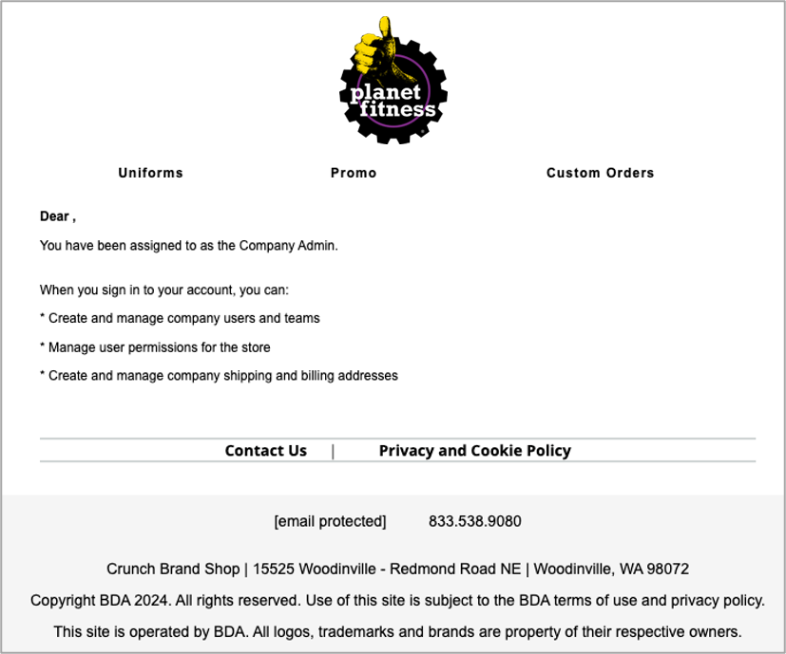
Step 1: Locate the admin invitation email you received.
You will be receiving an email from pfstore@bdainc.com, inviting you to your new company admin panel. Please click the link in the body of the email, which will take you to your new merchandise store!
When you sign-in for the first time, you will need to do a password reset to set up your actual password. See the next slide for screenshots of the process.
The link in the initial invite email will only be available from 9/2 – 9/4, if you are unable to access the link, please reach out to Customer Service.
© 2024 Bensussen Deutsch & Associates, LLC. Reproduction without permission is prohibited | CONFIDENTIAL

Slide 4
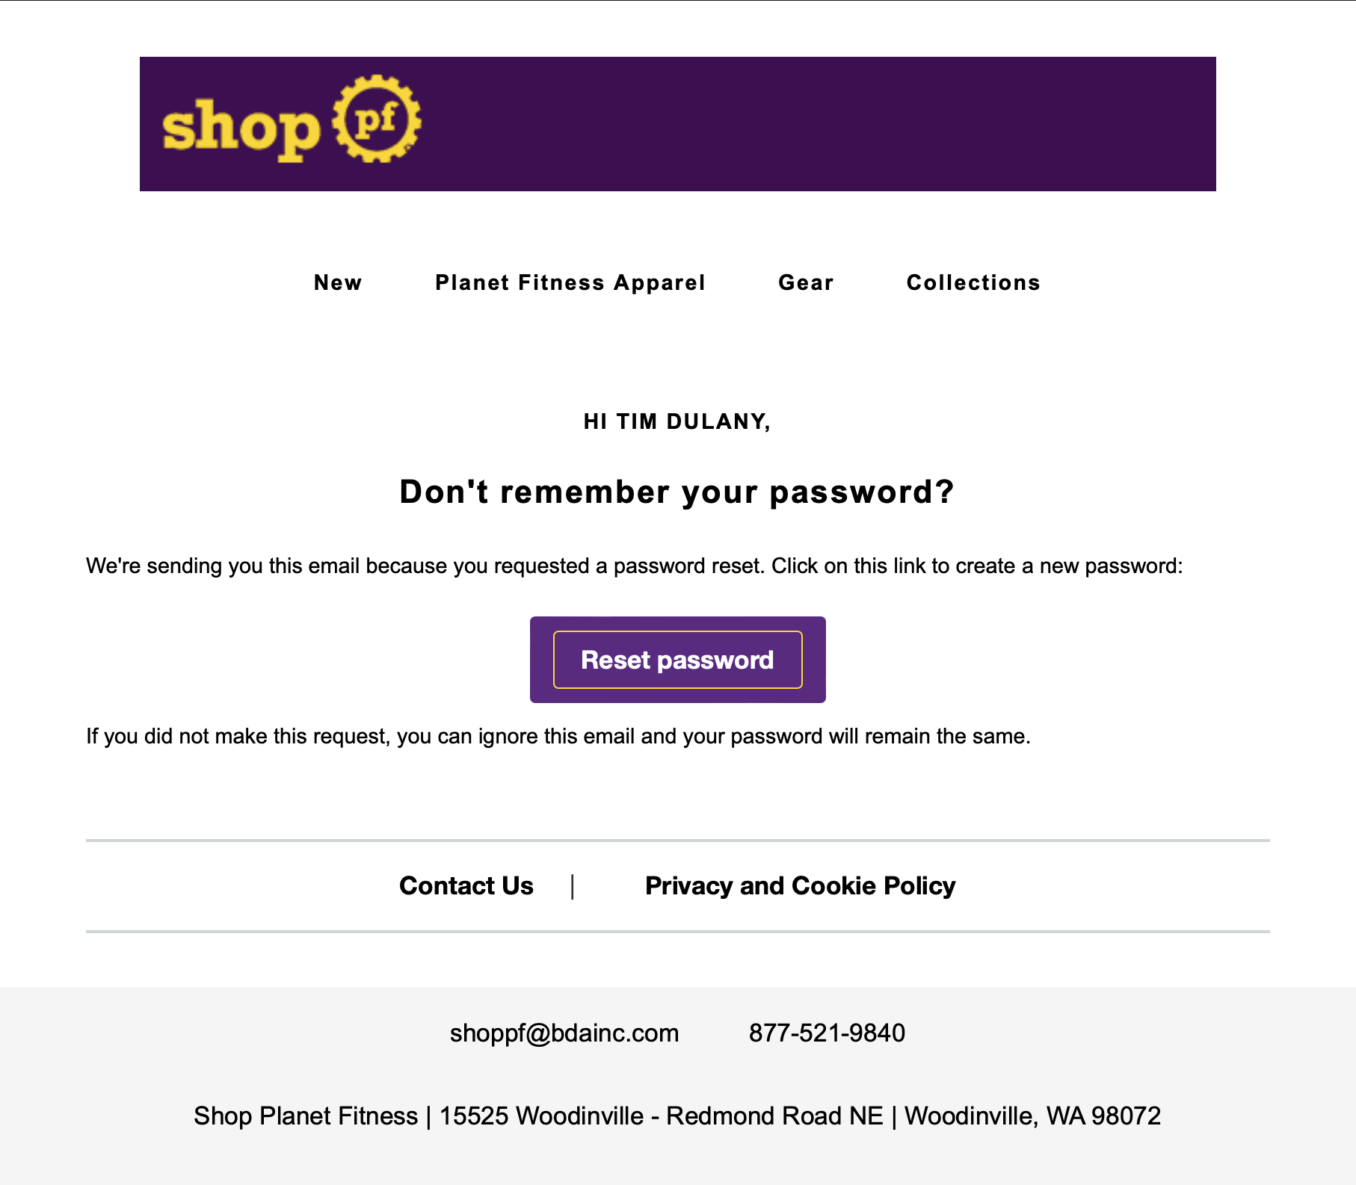
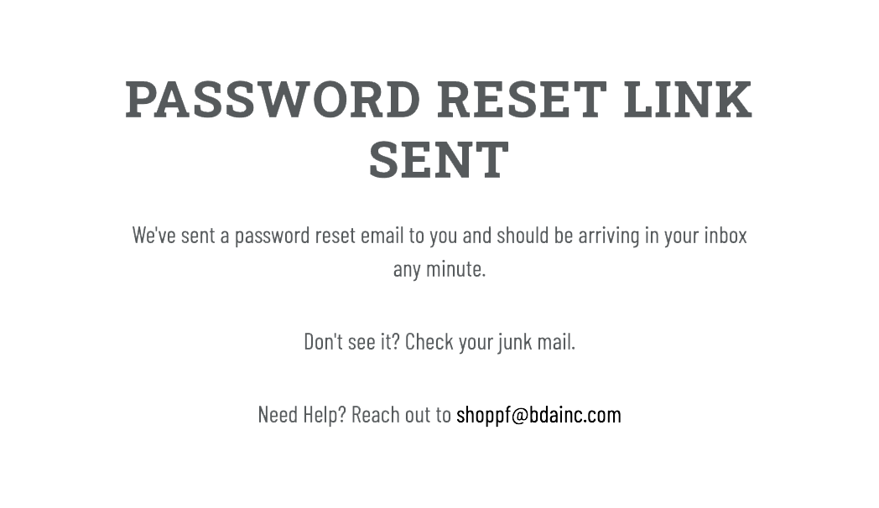
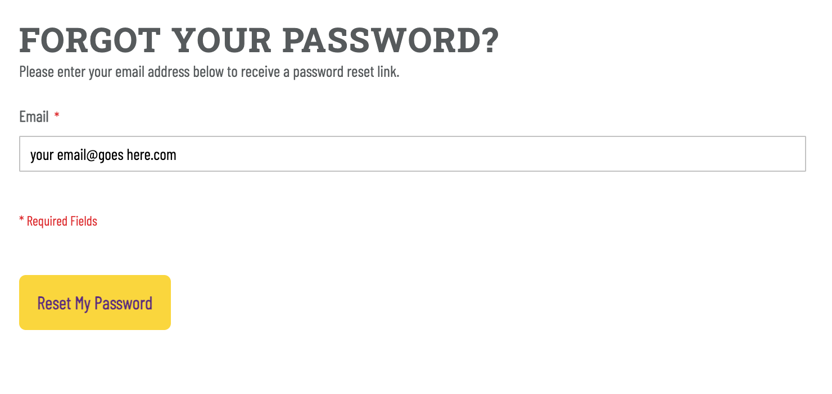
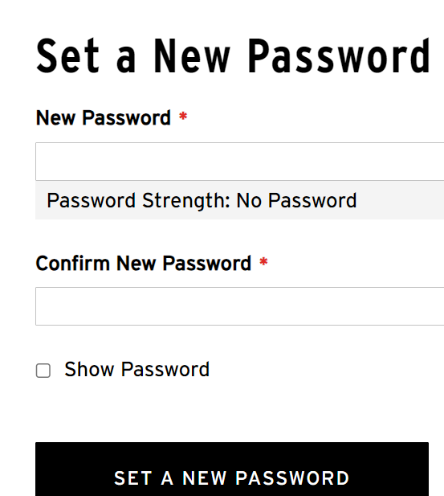
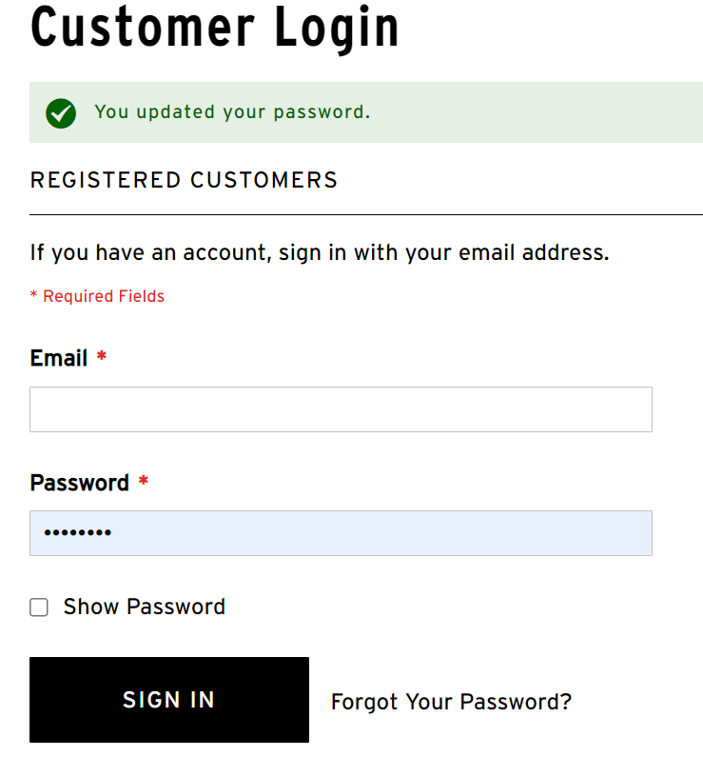
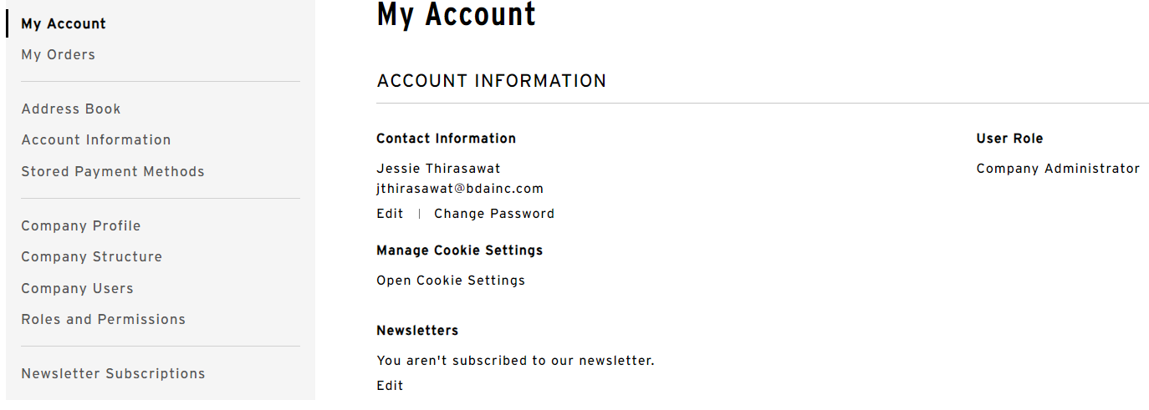
Step 2: Reset your password and login.
© 2024 Bensussen Deutsch & Associates, LLC. Reproduction without permission is prohibited | CONFIDENTIAL

Slide 5
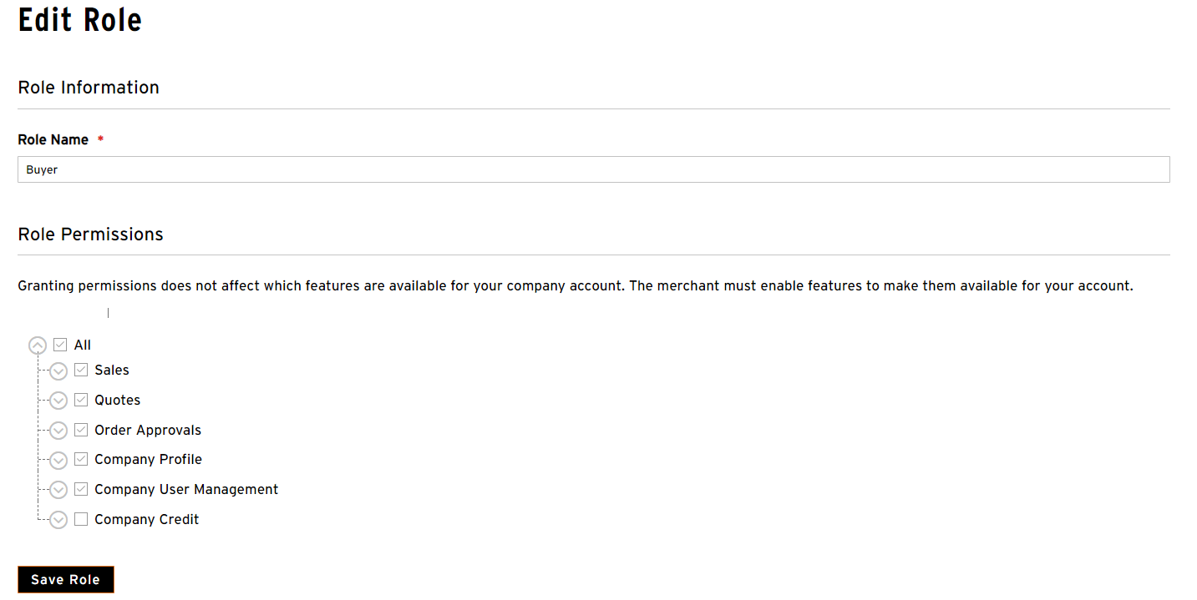
Step 3: Navigate to Roles & Permissions.
Navigate to and select “My Account”, located in the drop-down menu under your name in the upper right-hand corner of your screen.
Once on the “My Account” page, go to “Roles and Permissions”, found in the left navigation menu.
When adding new users to your company, you will need to assign each of them an appropriate role from this section. BDA has already configured a “Default” role for your convenience!
Optional Step: If you wish to create a new role, click "Add New Role". Enter in the role name you intend to create. Then, specify the permissions you wish to associate with this role. Saving the role completes the process.
© 2024 Bensussen Deutsch & Associates, LLC. Reproduction without permission is prohibited | CONFIDENTIAL

Slide 6
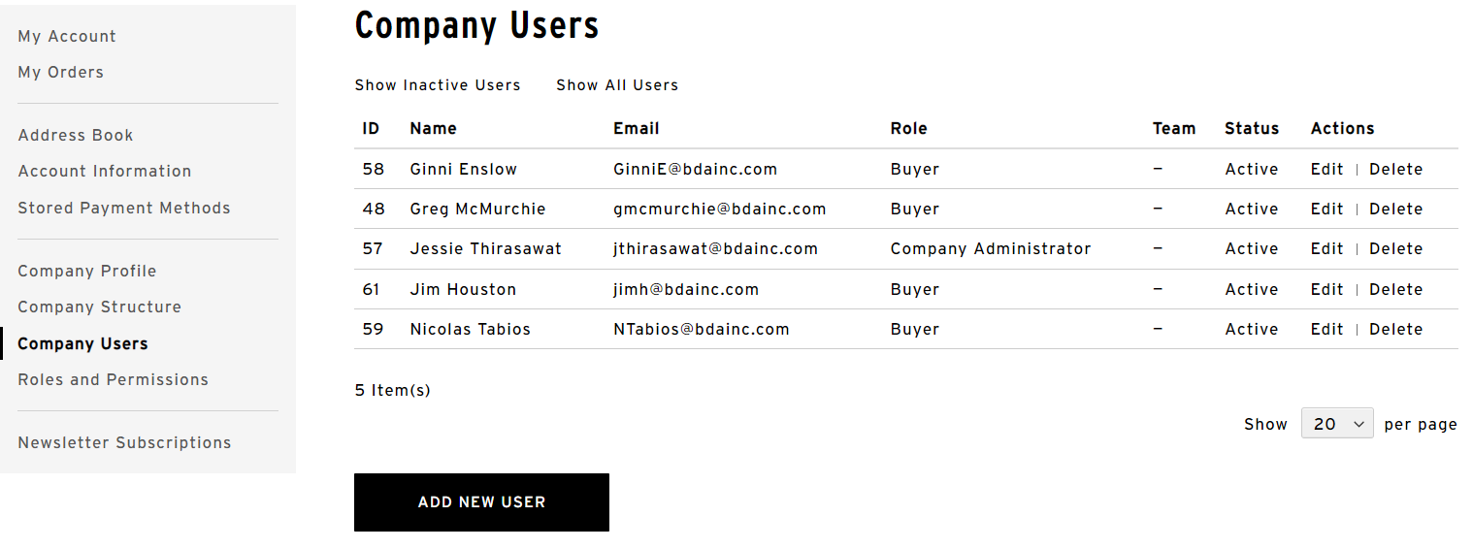
Step 5a: Add users to your company.
Begin by clicking “Company Users” on the left navigation menu. Then, click the "Add New User" button.
© 2024 Bensussen Deutsch & Associates, LLC. Reproduction without permission is prohibited | CONFIDENTIAL

Slide 7
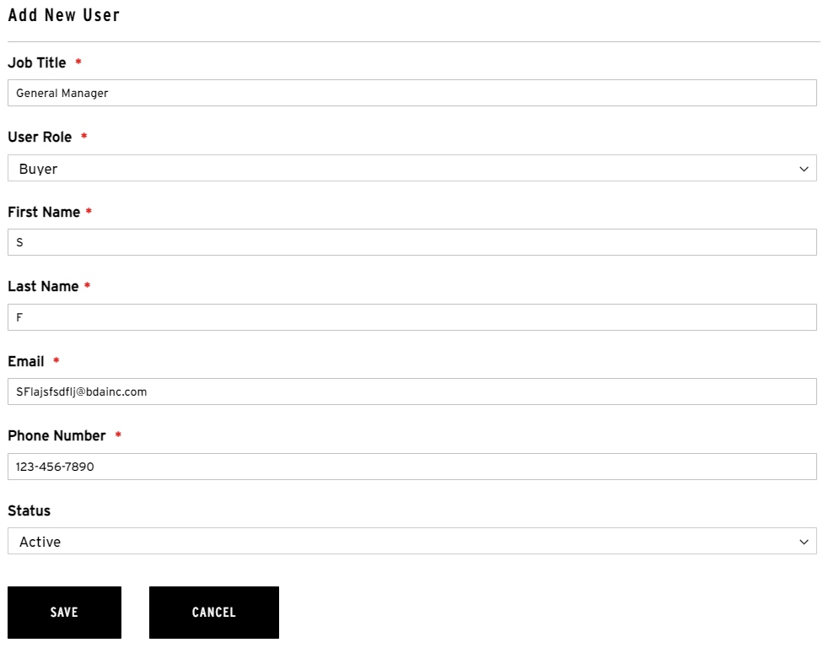
Step 5b: Add users to your company.
Fill out each field on the “Add New User” form. Under the “User Role” section, “Buyer” will already be listed, BDA has configured this as a “Default” role for your convenience!
Be sure to update the “Status” to “Active”. Once complete, click the Save button. After clicking Save, an email will automatically be sent to the new user informing them that an account has been created for them.
© 2024 Bensussen Deutsch & Associates, LLC. Reproduction without permission is prohibited | CONFIDENTIAL

Slide 8
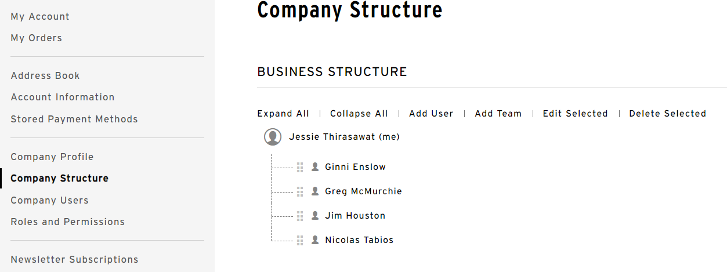
Step 6: Build your company structure. (Optional)
The “Company Structure” feature allows you to establish a hierarchical system of users. This hierarchy dictates the visibility and access permissions a user has when viewing orders within your organization.
For instance, if you want to assign roles such as “Manager” and “Buyer” within your company, you can organize all buyers to be under the manager. This setup allows the manager to view all orders placed by their assigned buyers, while each individual buyer can only access and manage their own orders.
To establish a hierarchy, click on a user's name and drag them under the appropriate supervisor. Alternatively, click on the supervisor's name and select "Add User" to add a new user as a subordinate to the selected supervisor.
© 2024 Bensussen Deutsch & Associates, LLC. Reproduction without permission is prohibited | CONFIDENTIAL

Slide 9
Admin FAQ’s
1. How do I (Admin) access the Planet Fitness merchandise store?
Answer: You (Admin) can access the Planet Fitness merchandise store by logging in with the credentials provided to you by Planet Fitness’ merchandise partner, BDA. If you (Admin) are logging in for the first time, on the log in page, you will need to select, “Forgot your password?” and enter in the username (email) that received the “Assigned to (your company name) as Company Admin” email. Once you have successfully updated your account with your new password you have access to the full Planet Fitness merchandise store.
2. Can I view orders placed by other users within my company?
Answer: Yes, as an Admin, you can view all orders that the users within your company have placed. From the My Account page, navigate to My Orders on the left navigation to see all orders by your users.
3. How do I disable a user?
Answer: From the My Account page, navigate to the Company Users on the left navigation. There you can select the user you want to disable by clicking "Edit". A dialog box will open where you can change the user's status from “Active” to “Inactive” and then click save.
4. What should I do if I need to update my account information or contact details?
Answer: You can update your account information by logging in, navigating to My Account > Account Dashboard, and clicking on the edit link next to the information you want to update (e.g., address, phone number).
5. What should I do if I encounter issues with placing orders or accessing certain features?
Answer: If you experience any issues, first check with your sales representative to ensure you have the correct permissions. If problems persist, you can contact customer support at 877-521-9840.
6. What should I do if I need to change my company information or admin?
Answer: If you need to make any changes, contact customer support at 877-521-9840 or pfstore@bdainc.com
© 2024 Bensussen Deutsch & Associates, LLC. Reproduction without permission is prohibited | CONFIDENTIAL

Slide 10
Added User FAQ’s
1. How do I access the Planet Fitness merchandise store?
Answer: You (Added User) can access the Planet Fitness merchandise store by logging in with the credentials provided to you by your company admin (Club Owner). If you (Added User) are logging in for the first time, on the log in page, you will need to select, “Forgot your password?” and enter in the username (email) that received the “You’ve been linked to a company” email. Once you have successfully updated your account with your new password you have access to the full Planet Fitness merchandise store.
2. Can I place orders on behalf of my company?
Answer: Yes, if you have been assigned the appropriate permissions by your company admin (Club Owner), you can place orders on behalf of your company. Sign in and then navigate to the catalog, select products, and proceed to checkout as usual.
3. How do I view orders that I've placed on behalf of my company?
Answer: You can view orders you've placed by logging into your Planet Fitness merchandise store account, navigating to My Account > My Orders. Here, you can see a list of all orders placed under your account.
4. What should I do if I need to update my account information or contact details?
Answer: You can update your account information by logging in, navigating to My Account > Account Dashboard, and clicking on the edit link next to the information you want to update (e.g., address, phone number).
5. Can I view orders placed by other users within my company?
Answer: No, as a regular user, you can only view orders that you have personally placed. Only company admins (Club Owners) or users with specific permissions can view orders placed by others within the company.
7. What should I do if I encounter issues with placing orders or accessing certain features?
Answer: If you experience any issues, first check with your company admin to ensure you have the correct permissions. If problems persist, you can contact customer support at 877-521-9840 or pfstore@bdainc.com
© 2024 Bensussen Deutsch & Associates, LLC. Reproduction without permission is prohibited | CONFIDENTIAL

